Slide 1
Database Architecture
1

Slide 2
Lecture - Objectives
Purpose of three-level database architecture.
Contents of external, conceptual, and internal levels.
Data Independence: logical and physical data independence.
Distinction between DDL and DML.
A classification of data models.
© Pearson Education Limited 1995, 2005

Slide 3
Objectives of Three-Level Architecture
All users should be able to access same data.
Each user may require a different view of the data held in DB
A user's view is immune to changes made in other views.
Users should not need to know physical database storage details.

Slide 4
Objectives of Three-Level Architecture Proposed by ANSI-SPARC
DBA should be able to change conceptual structure of database without affecting all users.
DBA should be able to change database storage structures without affecting the users' views.
Internal structure of database should be unaffected by changes to physical aspects of storage.
ANSI-SPARC ( American National Standards Institute
Standards Planning and Requirements Committee)

Slide 5
ANSI-SPARC Three-level Architecture
External Level
  Users' view of the database. Describes that part of database that is relevant to a particular user.
Conceptual Level
  Community view of the database. Describes what data is stored in database and relationships among the data.

Slide 6
ANSI-SPARC Three-level Architecture
Internal Level
  Physical representation of the database on the computer. Describes how the data is stored in the database.

Slide 7
Data Independence
Logical Data Independence
  Refers to immunity of external schemas to changes in conceptual schema.
  Conceptual schema changes e.g. addition/removal of entities.
  Should not require changes to external schema or rewrites of application programs.

Slide 8
Data Independence
Physical Data Independence
  Refers to immunity of conceptual schema to changes in the internal schema.
  Internal schema changes e.g. using different file organizations, storage structures/devices.
  Should not require change to conceptual or external schemas.

Slide 9
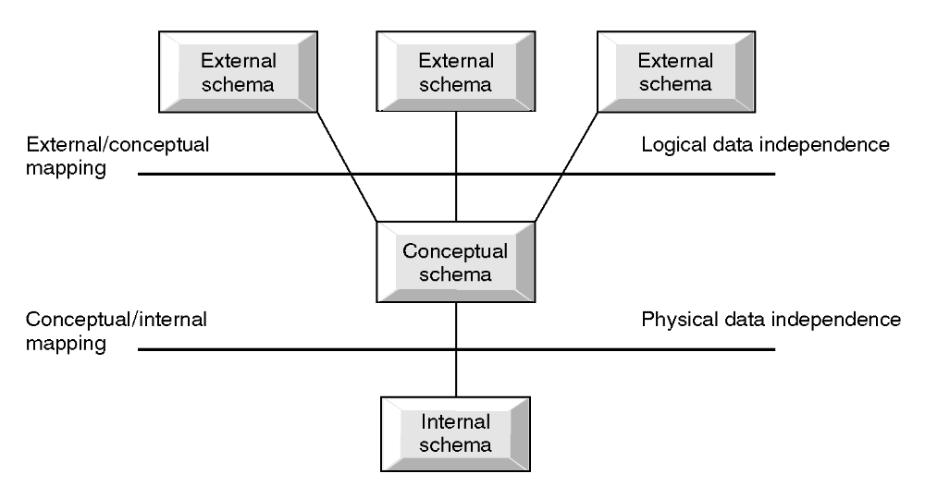
Data Independence and the ANSI-SPARC Three-level Architecture

Slide 10
Data Abstraction
Process of hiding irrelevant details from user is called data abstraction.
Three levels of abstraction are as follows:
  Physical level:
  The lowest level of abstraction describes how data are stored.
Database Systems 6e / Rob & Coronel
2- <number>

Slide 11
Logical level:
The next higher level of abstraction, describes what data are stored in database and what relationship among those data. This is middle level of 3-level data abstraction architecture.
View level:
Highest level of data abstraction. This level describes the user interaction with database system.
Database Systems 6e / Rob & Coronel
2- <number>

Slide 12
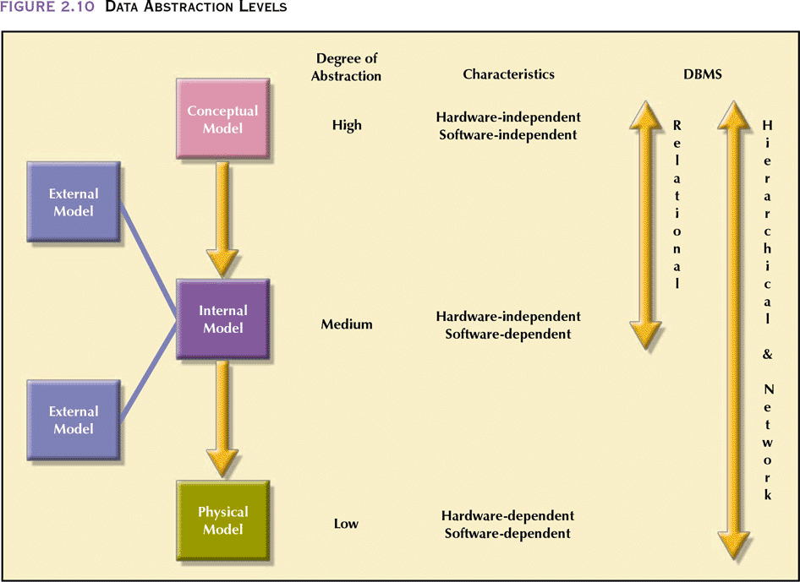
Data Abstraction Levels
Database Systems 6e / Rob & Coronel
2- <number>

